Slide 1

Sindh Engro Coal Mining Company Thar Block II Open Pit Lignite Mine Power Sourcing Economic Modeling
V4.0 | 02-05-24

Slide 2
Baseline Site, Load and Energy Data

Slide 3

Load Projection
The above load projection as well as hourly load data was combined to form hourly load projections over 12 years.

Slide 4
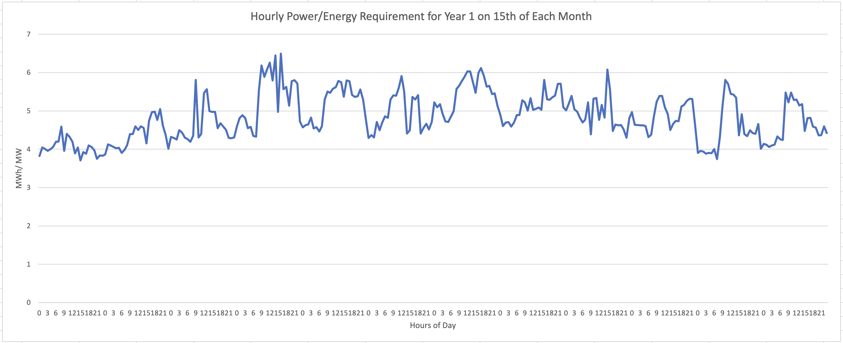
Hourly Energy Demand Projection
The first task of the model is to select sources that can meet the hourly energy demand.

Slide 5
Energy Demand

Slide 6
Key Assumptions

Slide 7
Assumptions
Exchange Rate: 1 USD = 290
Loss amount: PKR 24,000,000 per hour of critical load interruption
Loss duration: any load interruptions due to power failures are considered to be only one hour long. This is because most load interruptions will be caused by lack of stability and inadequate spinning reserve in the system
Existing generator sets capital cost: PKR 45,000,000 per MW.
Diesel Generator depreciation is not included in the financials.
Source probable failures and downtimes are defined as per experience for each source type (see Source Details)

Slide 8
Assumptions
BESS units provide instantaneous backup to any kind of power deficit due to inadequate capacity of sources or sudden reduction of capacity.
BESS units also provide long term power in case of power deficit.
Load shedding of non-critical load does not result in any financial loss.

Slide 9
Inflation Assumptions
Model incorporates different inflation levels for each source.
Solar and BESS sources have 5% inflation rate reflecting decreasing $/W cost due to technology improvements.
Steam Turbine source also has 5% inflation rate, as fuel is locally available at a subsidized cost.
Furnace oil and diesel fueled generator sources have a higher 7.5% inflation due to import dependence.
All financial numbers are in USD.
Inflation is not considered.

Slide 10
Details of Power Sources

Slide 11
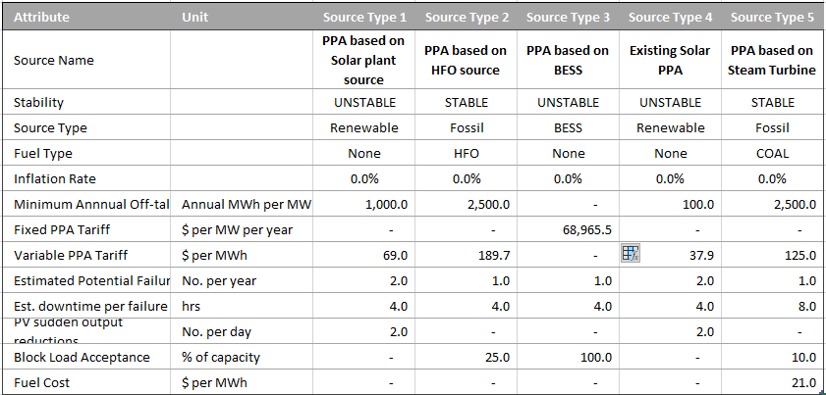
Source Details (PPA Sources)

Slide 12
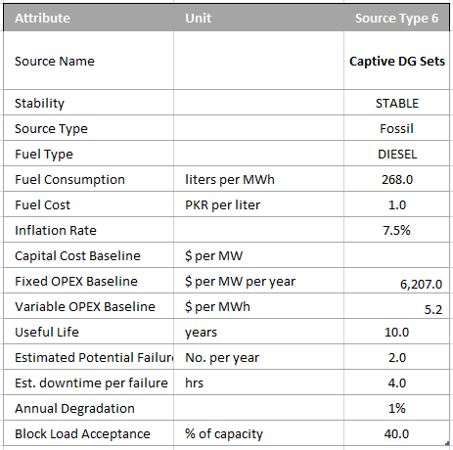
Source Details (Captive Source)

Slide 13
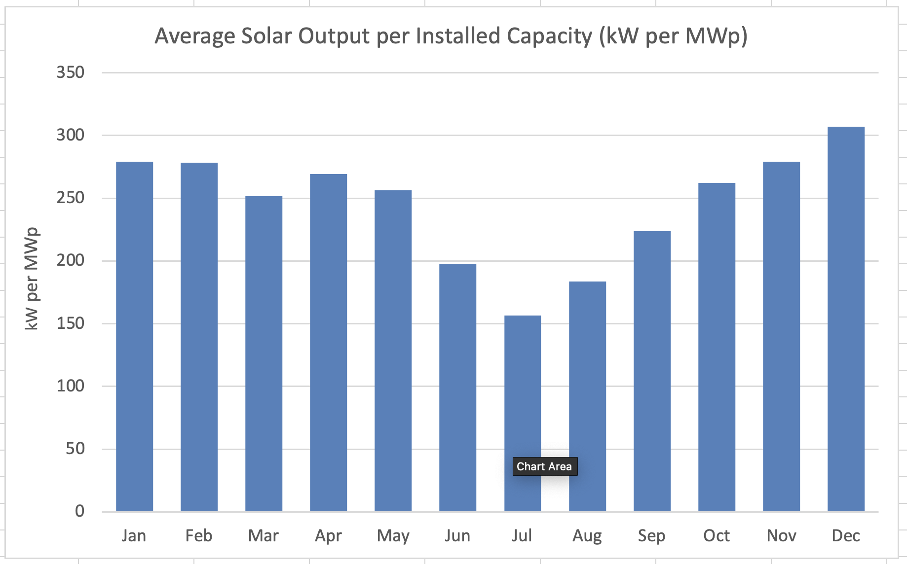
PV Generation Trend
Solar output from the existing 5MW plant remains low throughout the year.
However, during highly cloudy conditions in June-August, the average output drops under 200kW per MWp, which severely impacts PV and BESS sizing for options utilizing these sources.

Slide 14
Modeling Algorithm, Evaluation and Results

Slide 15
Model Algorithm/ Approach
Consider hourly power demand
Meet Remaining demand with least number of highest priority sources
Utilize Reserves and BESS, if needed to meet demand, otherwise preserve
Simulate probabilistic source failures
Check if operational sources/ BESS can meet sudden deficit within 4 seconds
If required, shed non-critical load,
Repeat for each hour in day, in month, in years (12)
Aggregate technical and commercial data
Input Load, Solar Profile and Source Configuration
Calculate Evaluation Metrics
Start
End
Operate Stable sources at min load req. for Spinning Reserve
Record data operating hourly data

Slide 16
Scenario Evaluation Metrics
1. Energy Fulfilment Ratio (%):
Calculated for each year and as a single metric
Number of hours in which power sources meet energy requirements without load shedding / total number of hours
Must be 99-100% for scenario to be viable
2. Critical Load Interruptions (No.):
Calculated for each year and as a single metric
Number of times critical load is interrupted due to source failures (and inadequate spinning reserve) despite non-critical load shedding
3. Load Shedding Events(No.):
Non-critical loads are shed if sources cannot meet critical load requirements. While this is not modeled to result in financial loss, it is a sustainability consideration

Slide 17


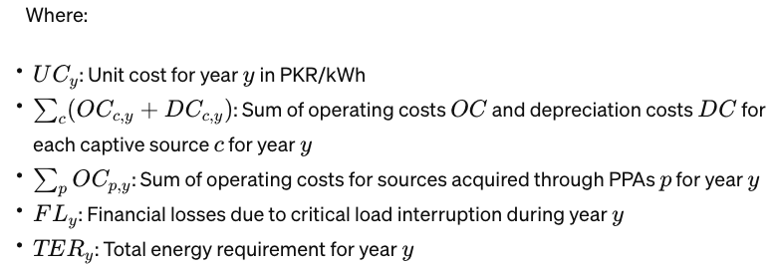
Scenario Evaluation Metrics (continued)
4. Average Unit Cost (AUC) in PKR/ kWh:

Slide 18
Scenarios being Modeled
1. Scenario 1
Retains existing 5MW Solar PV PPA, 6 x 1.5 MW Diesel Generators
Add 35MW Solar PV + 130 MWh BESS as Build-Own-Operate PPA on take-or-pay pricing. This config which has been recommended by a vendor and priced $0.13/ kWh for a 15-year term.
2. Scenario 2
Retains existing 5MW Solar PV PPA, 6 x 1.5 MW Diesel Generators
Corrects problems with Scenario 1’s new PV + BESS PPA configuration.
3. Scenario 3
Retains existing 5MW Solar PV PPA, 6 x 1.5 MW Diesel Generators
Provides a phased installation of new PV + BESS PPA to optimize costs

Slide 19
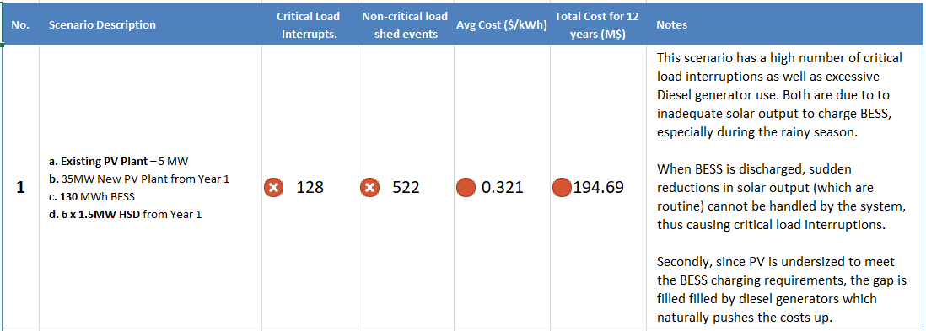
Summarized Modeling Outcomes

Slide 20
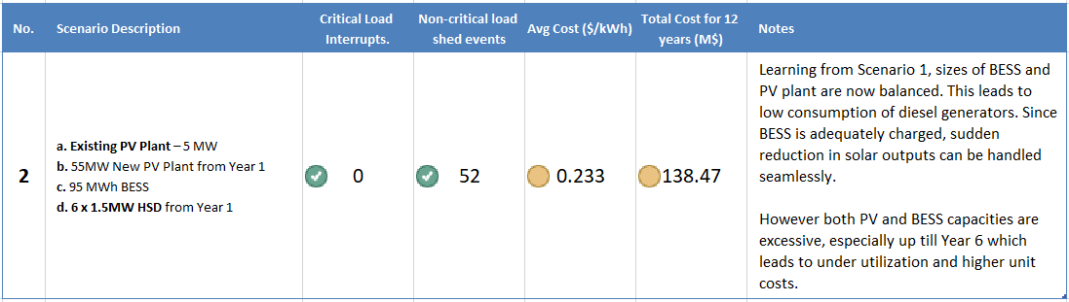
Summarized Modeling Outcomes (continued)

Slide 21
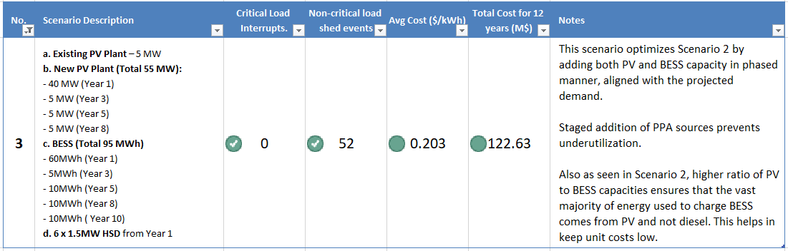
Summarized Modeling Outcomes (continued)

Slide 22
Scenario 1: Configuration
Source | Configuration/ Role | Priority in Meeting Demand
Existing 5MW Solar PPA | Operates from Year 1 to 12 as primary source | 1
Existing Diesel Generators | 6 x 1.5 MW operate from Year 1 to 12 as backup source | 3
New Solar PPA | 35 MW added in Year 1, to operate till Year 12 and beyond, as primary source | 1
New BESS PPA | 130 MWh added in Year 1 to operate till Year 12. First to respond to sudden and transient changes. | 2

Slide 23
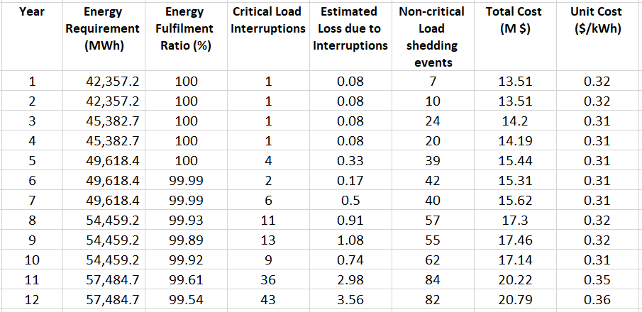
Scenario 1: Outcomes Summary
High Unit costs
High number of critical load interruptions especially in Years 7 to 12.
Years 6 to 11 have less than 100% energy fulfilment ratio, which means inadequacy of power sources leading to critical load shedding and production losses
High incidence of non-critical load shedding

Slide 24
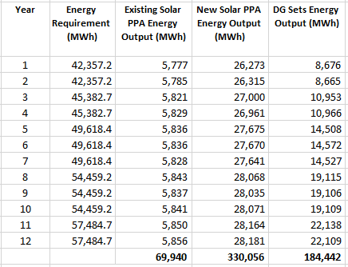
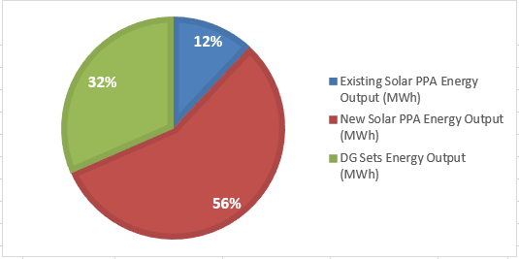
Scenario 1: Source and Year wise breakdown
Almost 32% of the energy required to feed the demand and charge BESS is provided by diesel generators.
This is the key reason behind high overall and unit costs in this scenario.
Clearly a better ratio of Solar power to BESS storage needs to be established, which is achieved in Sc 2

Slide 25
Scenario 2: Configuration
Source | Configuration/ Role | Priority in Meeting Demand
Existing 5MW Solar PPA | Operates from Year 1 to 12 as primary source | 1
Existing Diesel Generators | 6 x 1.5 MW operate from Year 1 to 12 as backup source | 3
New Solar PPA | 55 MW added in Year 1, to operate till Year 12 and beyond, as primary source | 1
New BESS PPA | 95 MWh added in Year 1 to operate till Year 12. First to respond to sudden and transient changes. | 2

Slide 26
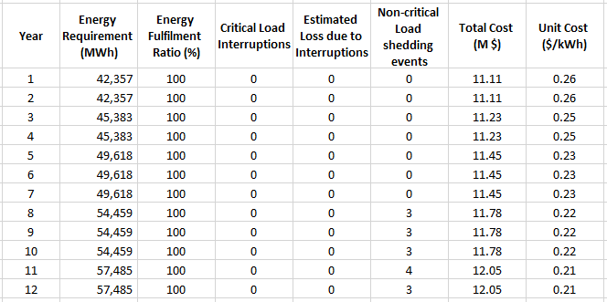
Scenario 2: Summary
All technical metrics i.e. critical load interruptions, energy fulfilment and load shedding are excellent.
However, the unit costs in early years are high as installing the full capacity from the beginning leads to overcapacity.

Slide 27
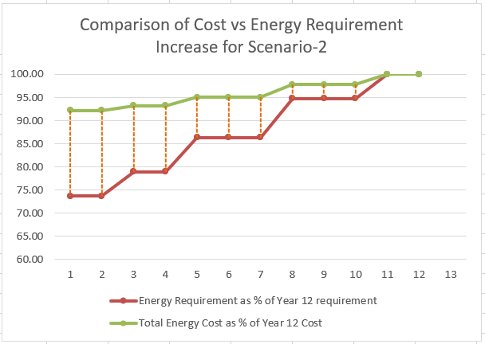
Scenario 2: Analysis of Over-capacity
Orange lines illustrate the extra capacity due to which the total costs in Years 1 and 2 are 92% of Year 12 cost, due the demand is less than 75%.
We can see that significant difference between energy requirement and costs proportions remain up till year 7.
This indicates the need to install new PV and BESS in a phased manner that aligns with the projected energy demand increase over the years.
Scenario 3 implements configuration adopted in Scenario 2 but in a phase manner.

Slide 28
Scenario 3: Configuration
Source | Configuration/ Role | Priority in Meeting Demand
Existing 5MW Solar PPA | Operates from Year 1 to 12 as primary source | 1
Existing Diesel Generators | 6 x 1.5 MW operate from Year 1 to 12 as backup source | 3
New Solar PPA | 40 MW added in Year 1, then 5MW each in Years 3, 5 and 8. All to operate till Year 12 and beyond as primary source | 1
New BESS PPA | 60 MWh added in Year 1, then 5MWh in Year 3; 10MWh in Years 5, 8, 10. All to operate till Year 12 and beyond. | 2

Slide 29
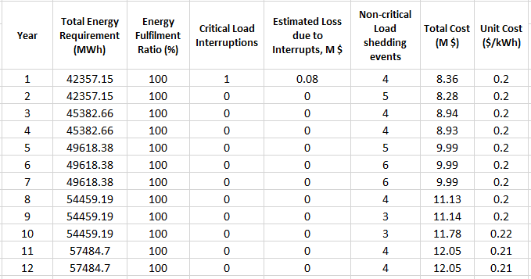
Scenario 3: Summary

Slide 30
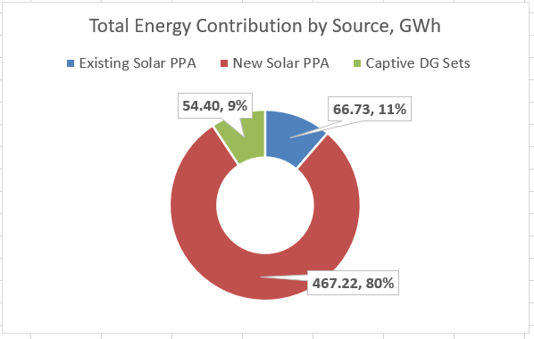
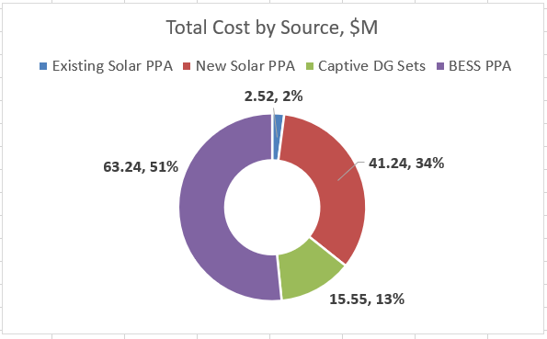
Scenario 3: Summary

Slide 31
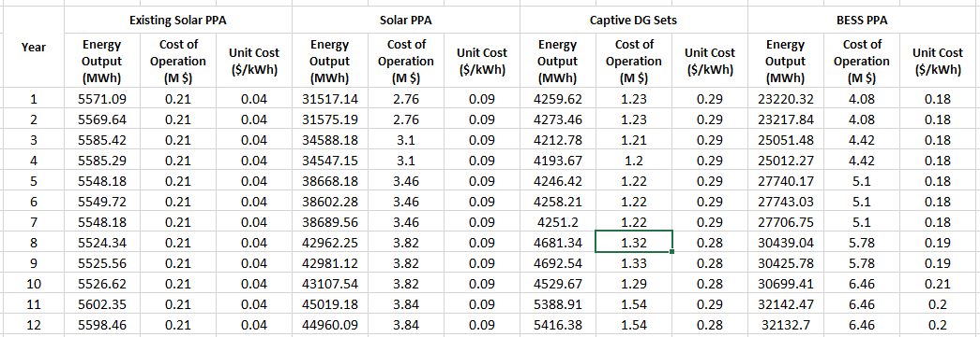
Scenario 3: Year-wise Source breakdown

Slide 32
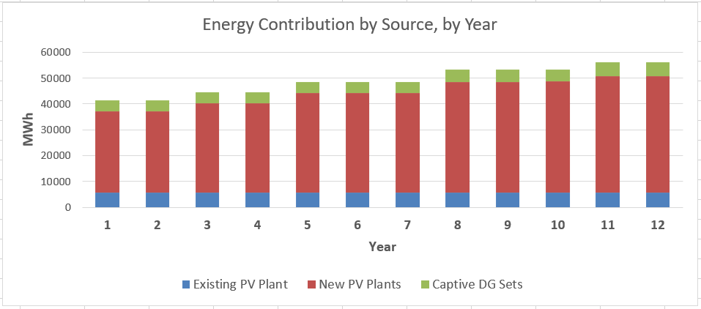
Scenario 3: Year-wise Source breakdown

Slide 33
Discussion
Scenario 1 has been created using a vendor-recommendation configuration
We see that recommendation configuration is not viable as it fails on all evaluation metrics.
Scenario 2 finds a configuration of sources that meet fulfilment, performance and reliability KPIs. However, due to over-capacity in early years, the unit cost of energy produced is high.
Scenario-3 optimizes Scenario 2 and provides a phased plan to build the required capacity of solar PV and BESS sources keeping unit costs consistently around $0.2/kWh
We recommend SECMC to move towards procurement using the configuration of Scenario-3.

Slide 34

Thank you!

